Slide 1


DATA TASK
WAQAS ZAHICK

Slide 2



KEY FACTS OF DATA INPUT / OUTPUT
Pre-processing
The raw data was in json format file: ‘supplier_car.json’

Slide 3
KEY FACTS OF DATA INPUT / OUTPUT
Pre-processing……
The json file (supplier_car.json) went through pre-processing or transformation process

Slide 4
KEY FACTS OF DATA INPUT / OUTPUT
Pre-processing……
converted json (supplier_car.json) data to initial 21,906 rows and 9 columns

Slide 5
KEY FACTS OF DATA INPUT / OUTPUT
Pre-processing……
There were multiple inputs (19) of a single data id

Slide 6
KEY FACTS OF DATA INPUT / OUTPUT
Pre-processing……
After analyzing the data, we figured out that the repetitions were the unique attributes of each of the 19 data id’s

Slide 7

KEY FACTS OF DATA INPUT / OUTPUT
Pre-processing……
Generated an excel (output) file (target data.xlsx) with 3 tabs i.e. pre-processing, normalisation and integration, via python programming

Slide 8
KEY FACTS OF DATA INPUT / OUTPUT
Pre-processing……
The output file (target data.xlsx) is generated simply by running the python or jupyter note file (data_task.jpynb)

Slide 9
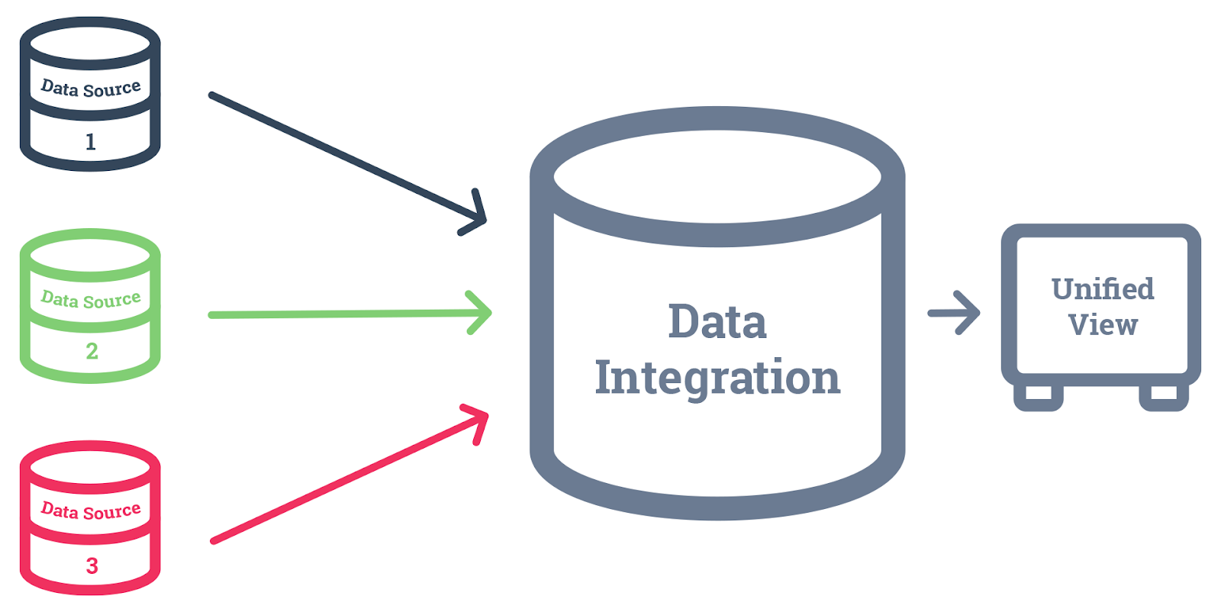
SUMMARY OF THE CHANGES MADE TO THE INPUT DATA
Data integration
Collaborated all the unique attributes of each id in the form of a directory

Slide 10
SUMMARY OF THE CHANGES MADE TO THE INPUT DATA
Data integration……
Dropped the duplicate data with respect to the id

Slide 11
SUMMARY OF THE CHANGES MADE TO THE INPUT DATA
Data integration……
Dropped columns of attribute names and attribute values in order to integrate all attributes as dedicated columns

Slide 12
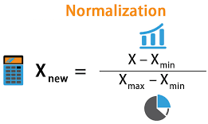
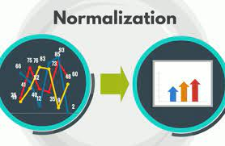
SUMMARY OF THE POTENTIAL CHANGES MADE TO THE INPUT DATA
Data normalisation
Normalized input data by assigning the ‘fuel’ (Benzine / diesel) and the ‘transmission’ (Manual / automatic) Boolean values of ‘0’ and ‘1’

Slide 13
SUMMARY OF THE POTENTIAL CHANGES MADE TO THE INPUT DATA
Data normalisation……
INPUT DATA CAN BE further NORMALIZED BY BEING CATEGORIZED or, by APPLYING more FILTERs to the input data such as……

Slide 14
SUMMARY OF THE POTENTIAL CHANGES MADE TO THE INPUT DATA
Data normalisation (applying filers)……
Filter for vehicle manufacture date before & after a certain date / year, for example, before & after year 2005; and……

Slide 15
SUMMARY OF THE POTENTIAL CHANGES MADE TO THE INPUT DATA
Data normalisation (applying filers)……
Filters for vehicle milage, Vehicle (horse) power, Vehicle carbon-emission rate, Vehicle (body) type etc.

Slide 16

CUSTOMER TAKE-AWAY MESSAGE
Take-away message
Clear, filtered, organized & simpler data that can help the customer make better, cost-effective and time-efficient decision(s).

Slide 17





THANK YOU!
waqas.Zahick@gmail.com
+61469888165
https://www.linkedin.com/in/waqas-zahick
https://github.com/waqaszahick

